Slide 1


Turntable MERG Arduino SIG
Part 1: Introduction
Meino de Graaf Mxxxx
Alan Lomax M8640
Notes:
MERG presentation for the Arduino SIG.
Prepared Jan / Feb 2023
Presented: (TBD)

Slide 2
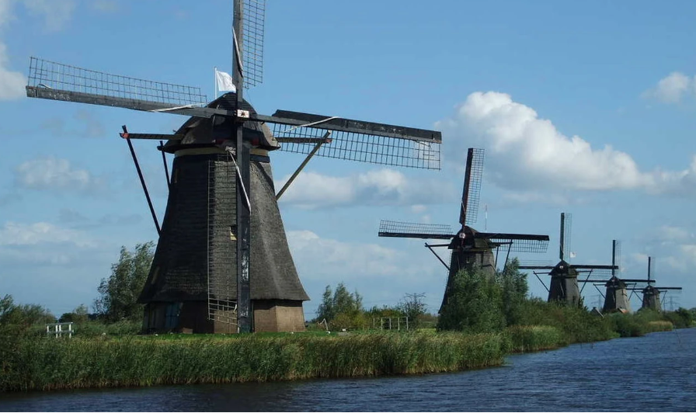

About Us
Meino de Graaf
calls Amersfoort, Holland his home
Alan Lomax
calls Ontario, Canada his home
Notes:
Introductions – a little bit about Alan!
Retired Electrical Engineer who worked in Petrochemicals – at first supporting maintenance and then doing Automation upgrade Projects
Technically – Networking plus Hardware and Software Integration. Focus was always control systems, safety shutdown systems and fault tolerant design.
Abnormal Situation Management – Ergonomic Factors
For the last few years I am back into model railways beginning with a rip and replace control system project!
Have been in MERG for less than two years, member of the Arduino SIG steering committee.
And.. I am not a professional programmer!

Slide 3
Agenda
Three sections to the presentation:
A General Introduction and Problem Statement
Meino’s solution
Alan’s solution
Notes:
In this first part … develop the general concepts
How we met the challenges will be covered in our own individual presentations.

Slide 4
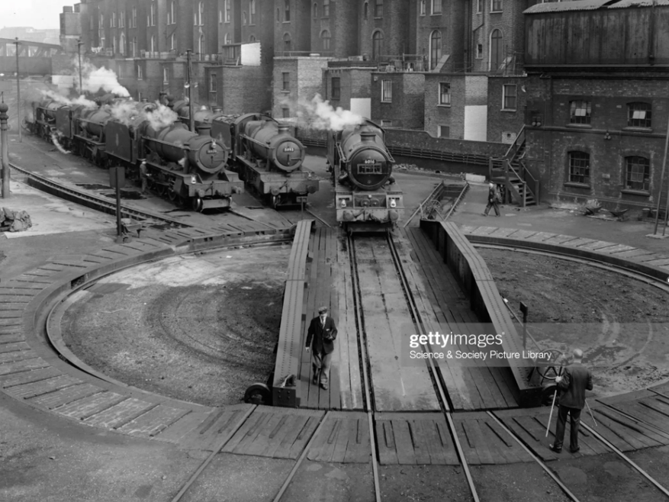
Details
Controlling a turntable can be simple
It can also be not so simple
You don’t need an Arduino
And yes it can be done with Meccano and a hand crank
Regardless of How there are some generic things that will need to happen ….

Slide 5
Details
On a Turntable the part that moves is called the bridge, (the stationary part is the well).
Of course we need to know the required stop location(s) for the bridge. Normally a track is located there. This is the target position
As the bridge rotates we need to know are we at a stop position? This is awareness of the current bridge position.
Something (or someone) needs to coordinate the motion to close the gap causing the bridge to stop in the right place. The Logic!
None of this says ‘Arduino’ … it could still be fingers and eyeballs.
BUT If we assume Arduino then the following block diagram will apply.

Slide 6
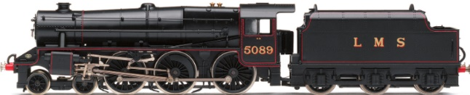
Turntable – Block Diagram
User Interface
Buttons
Lights
Turntable
Arduino
PositionSENSOR
Motor
Motor Power

Slide 7
Turntable – Expected Issues
As with many projects there are some initial questions to be answered and some issues that are easily anticipated.
What kind of turntable motor and how to drive it?
How to measure the bridge position?
Can we do it accurately enough?
What are the HMI requirements?
Will it all work?
Will an Arduino even be capable enough?

Slide 8
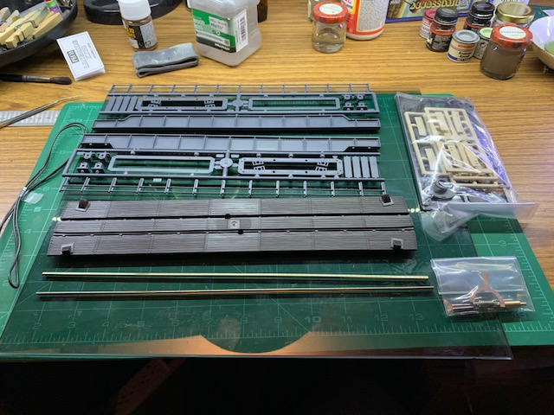
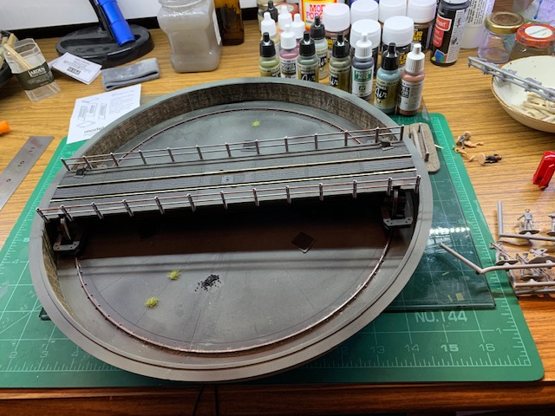
Turntable – Physical Basis
As it happens Meino and Alan both used the same physical kit – PECO LK-55

Slide 9
Turntable – Physical Basis
Beyond this we went about it independently.
In fact we only became aware of each others turntable project at a December Arduino SIG
So … we will now show our solutions in a bit more detail.

Slide 10
Questions?
Back to Agenda

